Slide 1
Indian cargo shipment

Slide 2
Cargo ship
A cargo ship or freighter is a merchant ship that carries cargo, goods, and materials from one port to another. Thousands of cargo carriers ply the world's seas and oceans each year, handling the bulk of international trade.
Cargo ships are usually specially designed for the task, often being equipped with cranes and other mechanisms to load and unload, and come in all sizes.
Today, they are almost always built of welded steel, and with some exceptions generally have a life expectancy of 25 to 30 years before being scrapped.
A packing list is a shipping document containing an itemized detailed list of the cargo, including weight, dimensions, safety measures, and packaging type.

Slide 3
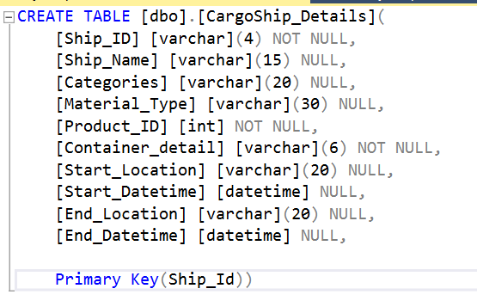
CargoShip_Details

Slide 4
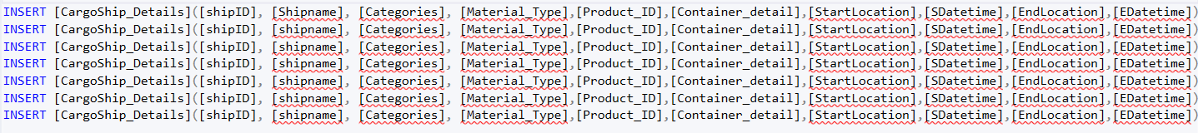
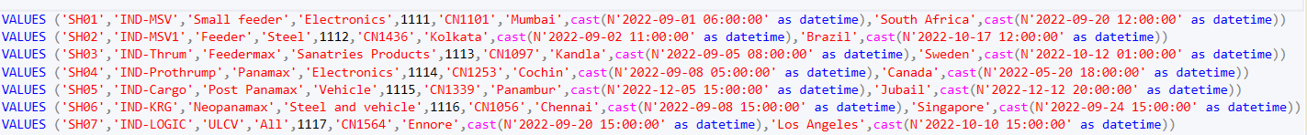
Data Insertion
INSERT [CargoShip_Details]([ship_ID],[Ship_Name],[Categories], [Material_Type], [Product_ID],[Container_detail],[Start_Location],[Start_Datetime],[End_Location],[End_Datetime])
VALUES ('SH01','IND-MSV','Small feeder','Electronics',1111,'CN1101','Mumbai',cast(N'2022-09-01 06:00:00' as datetime),'South Africa',cast(N'2022-09-20 12:00:00' as datetime))

Slide 5
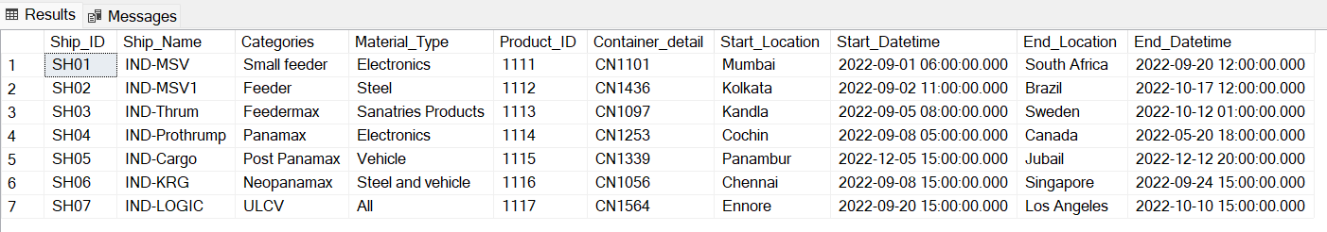

Slide 6
Thank you

